Slide 1
Presentation to the Community
And Stakeholders

Slide 2
Vision Defined
Not a Plan – Keep it in Context
Conceptual Elements for Planning
Pre-Planning for Future Community Dialog
Avoiding Chaos
Anticipating Future Needs
Recognizing and Developing Character
Establishing and Promoting a “Brand”
Deciding What to Say “Yes” to …
Notes:
VISION DEFINED
Not a Plan
Conceptual Elements for Planning
The Big Vision
Pre-Planning for Future Community Dialog
Being ready when the opportunities arise as they always do
Anticipating Future Needs
Recognizing and Developing Character
Establishing and Promoting a “Brand”
Deciding What to Say “Yes” to

Slide 3
Vision Goals
Community Branding and Identity
Needs Assessed
Assets Inventoried and Evaluated
Areas of Opportunity Identified
Implementable Strategies Developed
Best Practices and Tools Identified
Map the Community’s Future as a great place to live, work, play and learn.
Notes:
VISION DEFINED
Not a Plan
Conceptual Elements for Planning
The Big Vision
Pre-Planning for Future Community Dialog
Being ready when the opportunities arise as they always do
Anticipating Future Needs
Recognizing and Developing Character
Establishing and Promoting a “Brand”
Deciding What to Say “Yes” to

Slide 4
Regional Perspective
Vision2020 San Fernando Valley - 2001
15 General Community Indicators
Initial Target Categories
Deferred Categories
Sustainable Communities
Town Centers
Mobility and Circulation
Notes:
Regional Perspective
Connecting Infrastructure & Transportation
Marketplace Analysis - Regional Context
Competitive Advantages
Quality of Life Comparisons
Access to Amenities

Slide 5
Northridge Vision Campaign
Must be Organic – Reflective of Community
Unique Demographics and Culture
Must be Realistic — Attainable and Scaled
Must be Sustainable — Future Support
Must be Positive – Proactive vs. Reactive
Broad Stakeholder Support
Balance Regulation and Entitlement Options
Provide Reliable Support for “Vision-Friendly” Projects and Initiatives

Slide 6
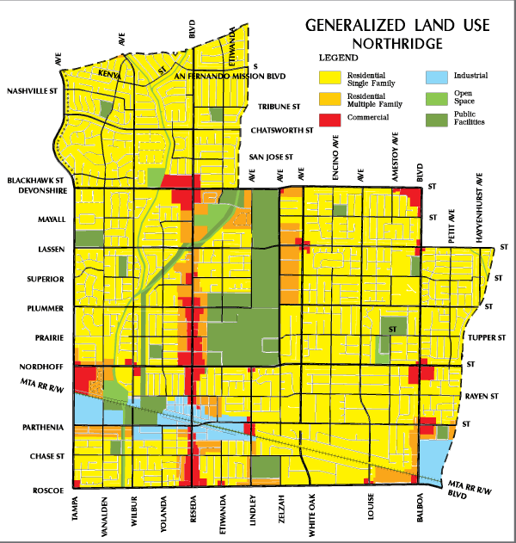
Defining the Northridge Community
Northridge is home to over 80,000 residents
Located in the geographic San Fernando Valley
An urban-suburban region of nearly two million
Geologically defined by mountain ranges on all sides
One of 82 communities in the City of Los Angeles
CSUN students and Faculty
Residents tend to be older
Residents tend to appreciate living the Valley
High ratio of owner-occupied housing
Notes:
How the Community is Seen
Mostly in the General Plan

Slide 7
Defining the Northridge Community
Newer arrivals are a more diverse group
Many are first-generation Latin or Asian immigrants
At 14 %, Hispanic population is less than the Valley at 42%
Asian population at 18 % is more than the Valley at 11 %
African Americans at 6% compared to the Valley at 4%
Incomes tend toward the upper-middle $75,000 range
Many are entrepreneurs, professionals and managers
Notes:
How the Community is Seen
Mostly in the General Plan

Slide 8
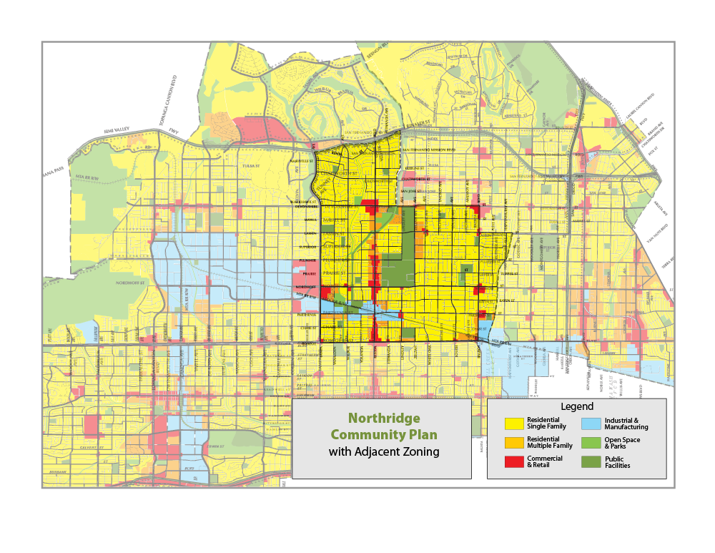
Defining the Community
Notes:
Northridge Community Plan
Regional Perspective
Adjacent Zoning
Commercial
Industrial

Slide 9
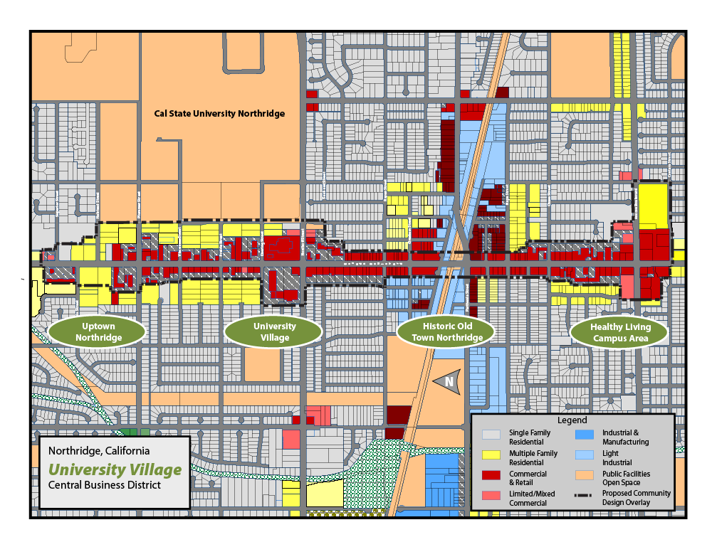
Notes:
Streets
Improve Mobility [Englander]
Improve Active Transportation and Pedestrian Orientation
Enhance Community Aesthetics – The Window to Northridge
Create a Regional Destination
CSUN as a Unique Asset, a market driver, point of pride,
The Valley’s Only Major University

Slide 10
University Village
Stretch of the Reseda Boulevard corridor adjacent to Cal State University Northridge
Generally recognized as Northridge’s town center.
Logical choice for a mixed-use, pedestrian-, and transit-oriented district.
Develop key intersections as gateways to Northridge and CSUN
Dining and open spaces a short walk from the Valley Performing Arts Center
A one-of-a-kind pedestrian-oriented arts and theatre district
Notes:
Streets
Improve Mobility [Englander]
Improve Active Transportation and Pedestrian Orientation
Enhance Community Aesthetics – The Window to Northridge
Create a Regional Destination
CSUN as a Unique Asset, a market driver, point of pride,
The Valley’s Only Major University

Slide 11
Historic Old Town
Ideally suited for public-private partnerships and the development of a vertically mixed-use area
Housing and a full array of local amenities
Metrolink station and transportation center provide an added incentive
Situate housing near the Parthenia and Reseda Boulevard intersection.
Notes:
Streets
Improve Mobility [Englander]
Improve Active Transportation and Pedestrian Orientation
Enhance Community Aesthetics – The Window to Northridge
Create a Regional Destination
CSUN as a Unique Asset, a market driver, point of pride,
The Valley’s Only Major University

Slide 12
Healthy Living Campus
Area is anchored by Northridge Hospital Medical Center
A medical, healthcare business and professional district
In the vicinity of the Roscoe and Reseda Boulevards intersection
Seeking Categorical “Children’s Hospital” Status
Notes:
Streets
Improve Mobility [Englander]
Improve Active Transportation and Pedestrian Orientation
Enhance Community Aesthetics – The Window to Northridge
Create a Regional Destination
CSUN as a Unique Asset, a market driver, point of pride,
The Valley’s Only Major University

Slide 13
Uptown Northridge
Lower intensity area
Mix of multi-family housing units MFHU and commercial uses
Area is suitable for a more horizontal mixed-use transition
Accommodate RHNA requirements to accommodate housing growth
Notes:
Streets
Improve Mobility [Englander]
Improve Active Transportation and Pedestrian Orientation
Enhance Community Aesthetics – The Window to Northridge
Create a Regional Destination
CSUN as a Unique Asset, a market driver, point of pride,
The Valley’s Only Major University

Slide 14
Implementation
Respond to Opportunities as they Arise
Direct Resources to Priorities as Developed
Inform the Debate to Guide Policy Decisions
Intervene in Constructive Ways
Use the Vision as a Tool to Attract Investment
Keep the Vision and Process Alive and Current
Adapt to Changing Conditions

Slide 15
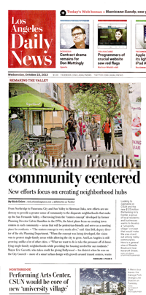
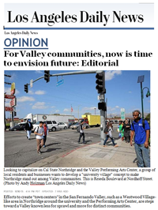
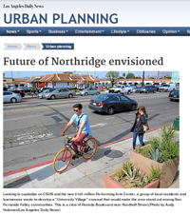
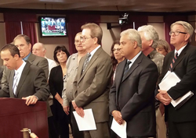
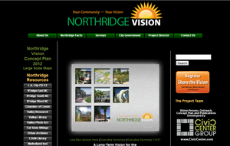
Outreach

Slide 16
Presentation to the Community
And Stakeholders

